Slide 1
Bank Loan Data Analysis
File created on: 6/10/2025 5:09:10 AM

Slide 2
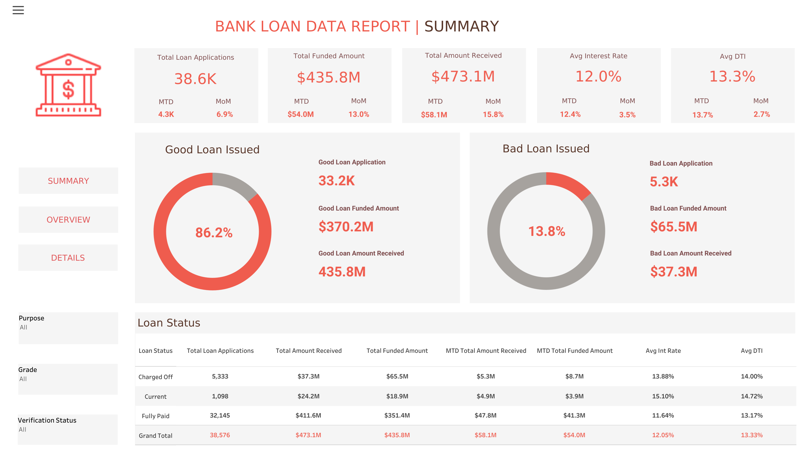

Slide 3
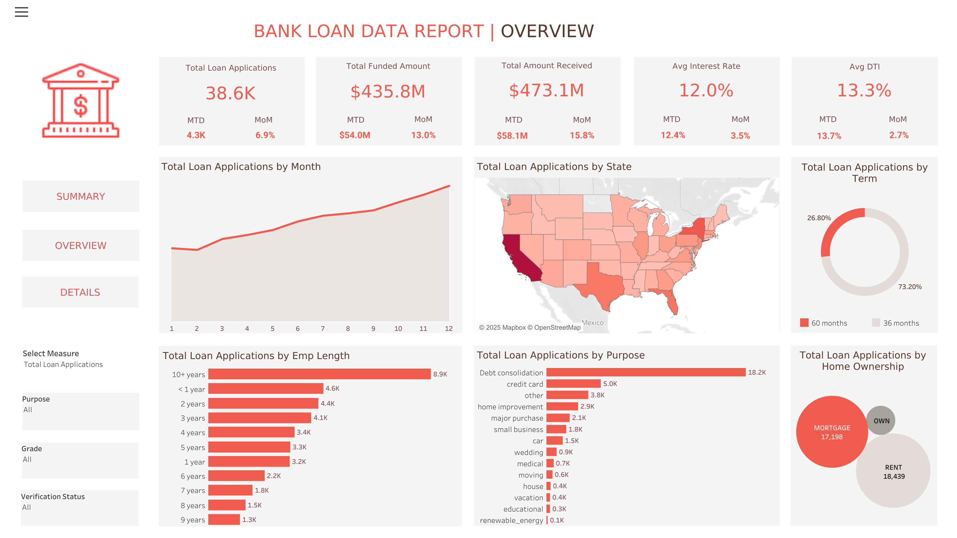

Slide 4
